Slide 1




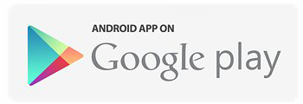
Main Presenter: Leslie Ho Zong Hong
from Team CUT-Q

Slide 2
CUSTOMER SEGMENT
Owners of:
Karaoke Studios
Karaoke Suits
Any Karaoke Entertainment Providers that offers private rooms (i.e. K-Boxes)

Slide 3








Slide 4
PROBLEM STATEMENT
General: Difficulty in achieving maximum revenue capacity due to a lack of consumer knowledge
More specifically, it is difficult to achieve potential revenue at full capacity during peak hours due to a lack of consumer knowledge

Slide 5
VALUE PROPOSITION CANVAS
Provide an overview on the rooms available across KTVs in SG at various timings
Establish a direct communication channel with customers on rooms available
Increase demand for unused rooms
Reduced cost associating with customer comms
A mobile application that assist customers in finding karaoke rooms for singing
Achieve max revenue Capacity
Equipping customers with the necessary tools and knowledge for finding available KTV rooms (i.e. raise awareness)
Unused rooms / spare capacity as patrons are unable to find available rooms; give up searching = loss of potential revenue for business owners

Slide 6

PROTOTYPE
Invision Link:
https://invis.io/DYDNPG6UJ

